Slide 1
Machine Learning
Analyzing the Theoretical Foundations and Popular Algorithms

Slide 2
Types of Learning Problems
1. Supervised Learning: Predict outcomes based on labeled data.
2. Unsupervised Learning: Identify patterns in unlabeled data.
3. Semi-Supervised Learning: Combine labeled and unlabeled data.
4. Reinforcement Learning: Learn behaviors through trial and error.

Slide 3
Taxonomy of Machine Learning Algorithms
1. Classification: Assign input data into predefined categories.
2. Regression: Predict continuous numeric values.
3. Clustering: Group similar data points together.
4. Dimensionality Reduction: Reduce the number of input variables.

Slide 4
Investigating Machine Learning Algorithms
Classification Algorithms: Decision Trees, SVM, Neural Networks.
Regression Algorithms: Linear Regression, Polynomial Regression, Random Forest Regression.
Clustering Algorithms: K-Means, Hierarchical Clustering,
Dimensionality Reduction: PCA, t-SNE, LDA.

Slide 5
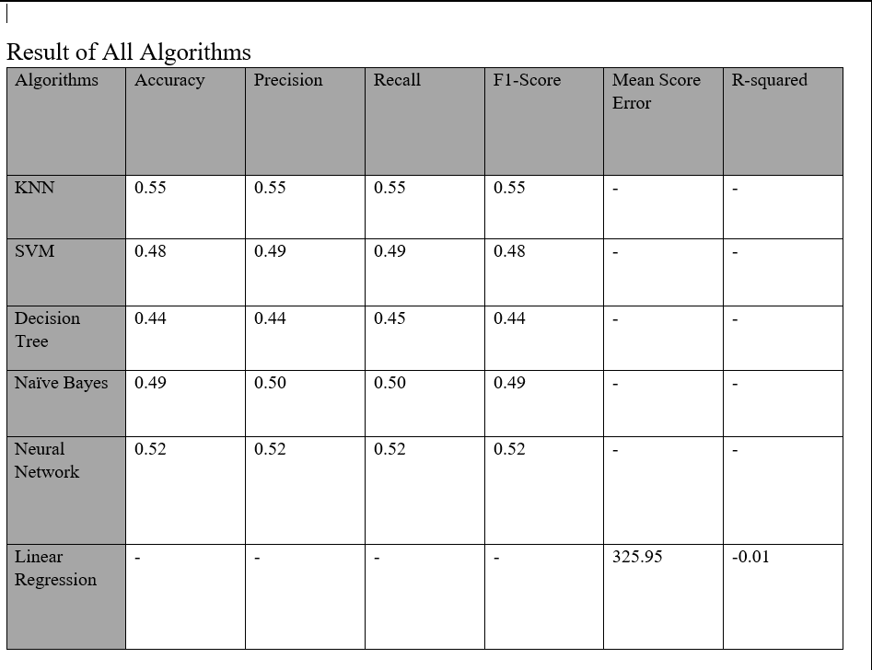
Efficiency Demonstration

Slide 6
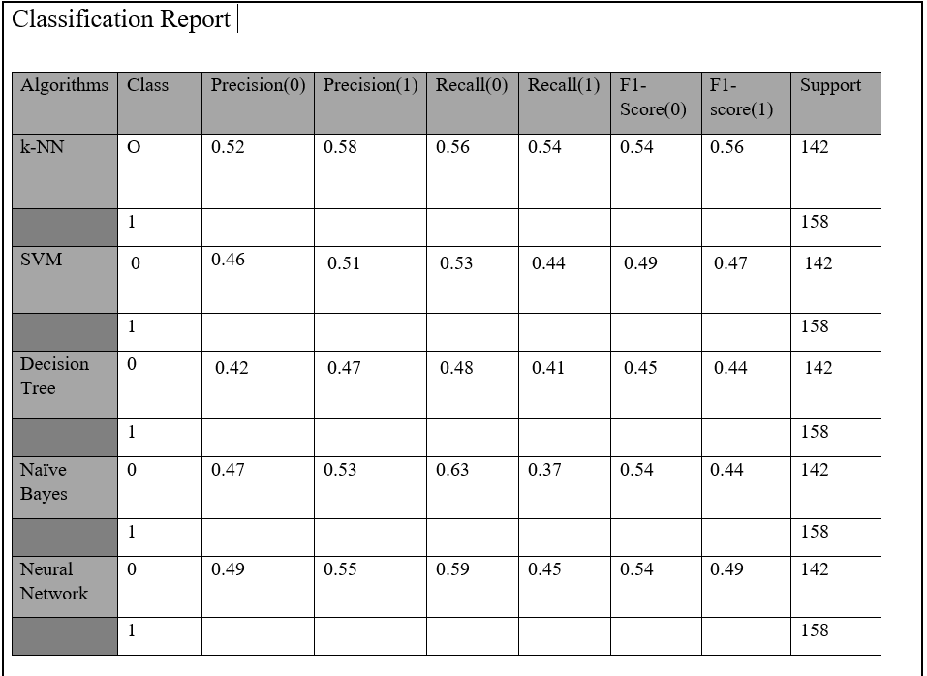
Classification Report Demonstration

Slide 7
Higher Grade Evaluation
K-NN had moderate accuracy and a balance between accuracy and recall.
SVM and Decision Tree showed lower performance, which indicated possible cases of overfitting.
Naive Bayes and Neural Networks provided weak results, emphasizing the importance of choosing an algorithm based on data characteristics.
Linear Regression’s negative R-squared value indicated limited predictive power for this dataset.

